Slide 1

Algebra 1
Unit 3, Lesson 5 Scatter Plots and Linear Relationships Volume 1, pg. 131

Slide 2


Benchmark
MA.912.DP.2.4
Fit a linear function to bivariate numerical data that suggests a linear association and interpret the slope and 𝑦-intercept of the model. Use the model to solve real-world problems in terms of the context of the data.
volume 1, pg. 131

Slide 3
Integrated Mathematical Thinking and Reasoning Standards
MA.K12.MTR.1.1 Actively participate in effortful learning both individually and collectively.
MA.K12.MTR.2.1 Demonstrate understanding by representing problems in multiple ways.
MA.K12.MTR.3.1 Complete tasks with mathematical fluency.
MA.K12.MTR.4.1 Engage in discussions that reflect on the mathematical thinking of self and others.
MA.K12.MTR.5.1 Use patterns and structure to help understand and connect mathematical concepts.
MA.K12.MTR.6.1 Assess the reasonableness of solutions.
MA.K12.MTR.7.1 Apply mathematics to real-world contexts.
volume 1, pg. 131

Slide 4

Learning Target
I can informally fit a straight line to model the relationship between two variables in a scatter plot.
I can interpret the slope and 𝑦-intercept of a linear function fit to bivariate numerical data in context.
I can determine an appropriate domain and range for bivariate numerical data based on the context.
volume 1, pg. 131

Slide 5

Warm-Up
volume 1, pg. 132

Slide 6
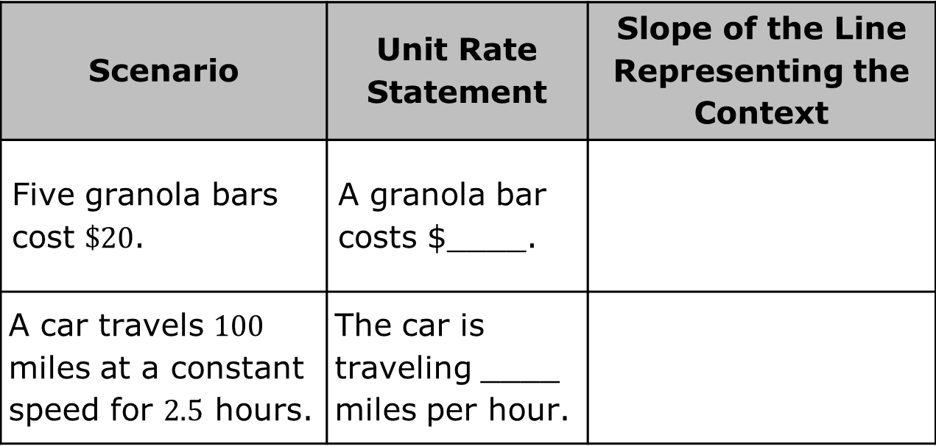
3.5.1 Warm-Up: Bell Work
Complete the table by calculating the value that completes each statement given the context and identifying the slope of the line that represents the context.
Scenario | Unit Rate Statement | Slope of the Line Representing the Context
Five granola bars cost $\$20$. | A granola bar costs $____.
A car travels $100$ miles at a constant speed for $2.5$ hours. | The car is traveling ____ miles per hour.
volume 1, pg. 132
Notes:
Video Link: https://algebranation.wistia.com/medias/fi4fidi5y8

Slide 7
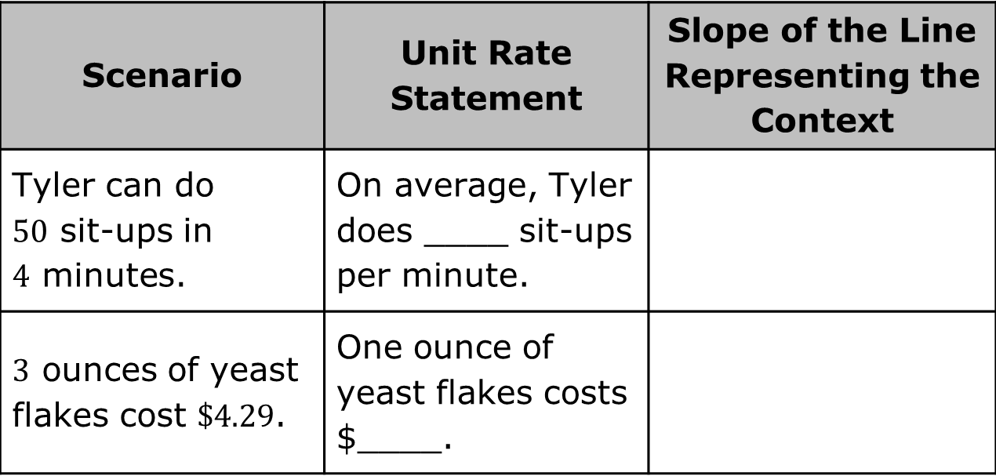
Scenario | Unit Rate Statement | Slope of the Line Representing the Context
Tyler can do $50$ sit-ups in $4$ minutes. | On average, Tyler does ____ sit-ups per minute.
$3$ ounces of yeast flakes cost $\$4.29$. | One ounce of yeast flakes costs $____.
volume 1, pg. 132
Notes:
Video Link: https://algebranation.wistia.com/medias/fi4fidi5y8

Slide 8

Refresher
volume 1, pg. 132

Slide 9


3.5.2 Refresher: Scatter Plots and Their Data
Linear equations can also be used to model the relationship between bivariate data that shows a linear relationship.
Bivariate numerical data can be represented using a scatter plot.
Bivariate data is data that measures two characteristics of a population.
A scatter plot is a graph in the coordinate plane representing a set of bivariate numerical data that is used to observe the relationship between two variables.
volume 1, pg. 132

Slide 10
Each point on a scatter plot represents a specific pair of values from the raw data. The 𝑥- and 𝑦-values are used to plot each data point in the coordinate plane. When all of the points in a data set are represented, a line of fit is often used to model the relationship between the two characteristics in the data set.
While different lines of fit can be drawn to model the relationship, the goal is to draw the line of best fit to most closely model the relationship and use it to make predictions.
A line of fit is a line drawn on a scatter plot to estimate the relationship between two sets of data. A line of fit is also known as a trend line.
volume 1, pg. 132

Slide 11
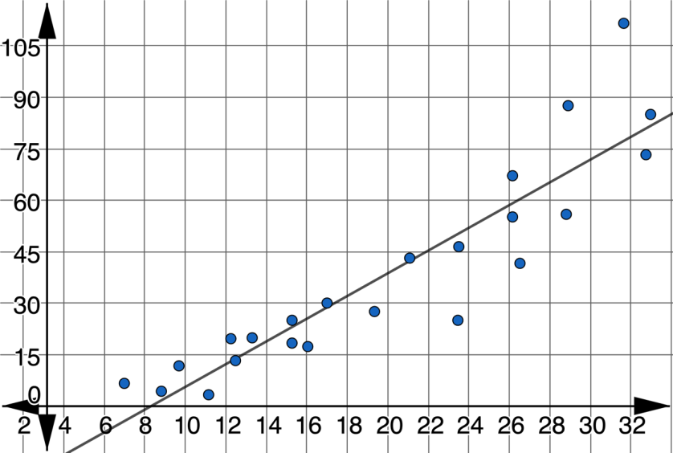
The relationship between the height and weight of $23$ dogs is shown.
Weight (in pounds)
Height (in inches)
volume 1, pg. 133

Slide 12

Complete the statements using the terms in the bank. Some terms will not be used. Do not use a term more than once.
The ________________________ shown above represents the relationship between _______________ data. The two variables being compared are the height and weight of $23$ dogs. The trend line, or _________________, estimates the relationship between these two variables. For this relationship, as dog height increases, the weight of the dog _____________________, so the trend line has a _____________________ slope.
bivariate | decreases | increases
line of best fit | negative | positive
 | scatter plot
volume 1, pg. 133

Slide 13

Collaboration
volume 1, pg. 133

Slide 14
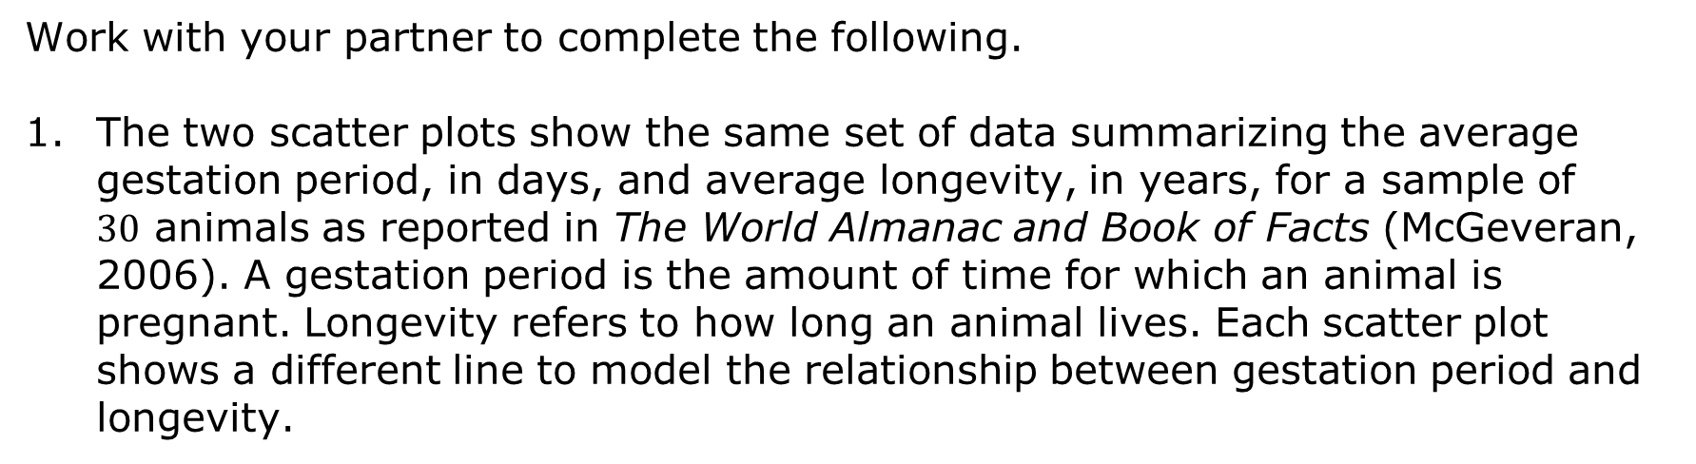
3.5.3 Collaboration: Scatter Plots and Patterns of Association
Work with your partner to complete the following.
The two scatter plots show the same set of data summarizing the average gestation period, in days, and average longevity, in years, for a sample of $30$ animals as reported in The World Almanac and Book of Facts (McGeveran, 2006). A gestation period is the amount of time for which an animal is pregnant. Longevity refers to how long an animal lives. Each scatter plot shows a different line to model the relationship between gestation period and longevity.
volume 1, pg. 133

Slide 15
Line of Fit A Line of Fit B
Discuss with your partner which scatter plot shows a line better fit to model the relationship. Summarize your discussion.
volume 1, pg. 133

Slide 16
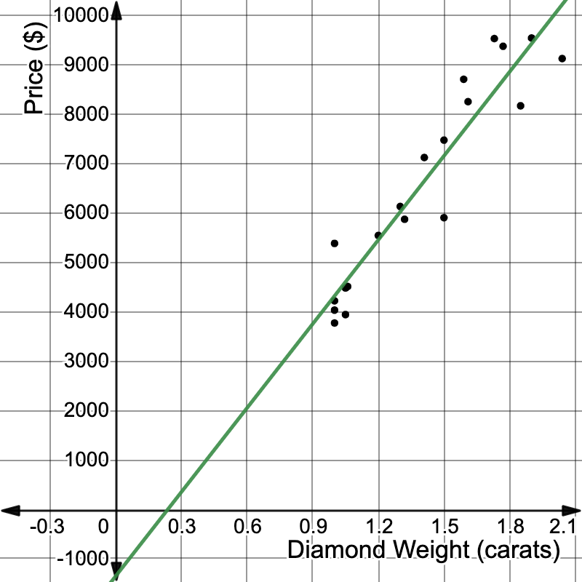
The scatter plot shows the relationship between the weight, in carats, and the price, in dollars, of $20$ different diamonds.
volume 1, pg. 134

Slide 17
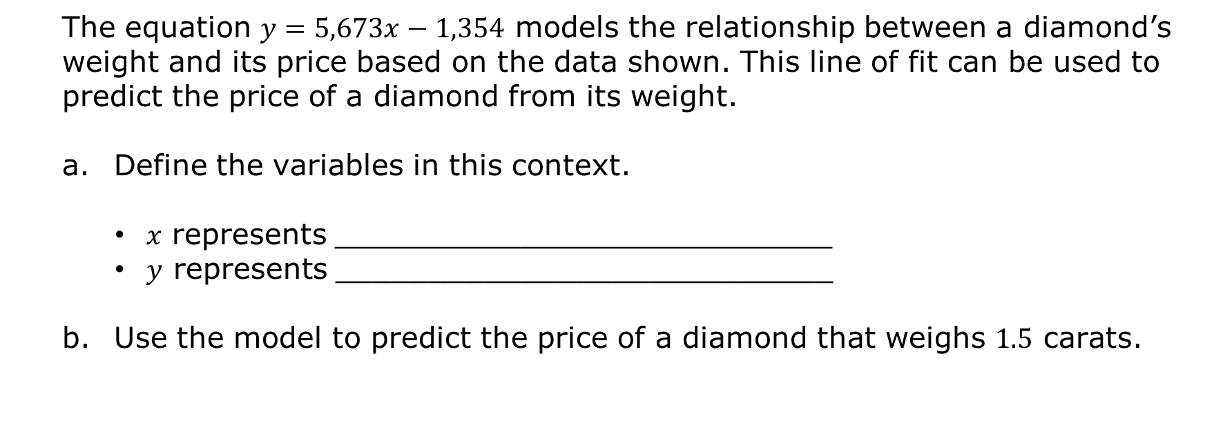
The equation $y=5,673x−1,354$ models the relationship between a diamond’s weight and its price based on the data shown. This line of fit can be used to predict the price of a diamond from its weight.
Define the variables in this context.
𝑥 represents ___________________________
𝑦 represents ___________________________
Use the model to predict the price of a diamond that weighs $1.5$ carats.
volume 1, pg. 134

Slide 18
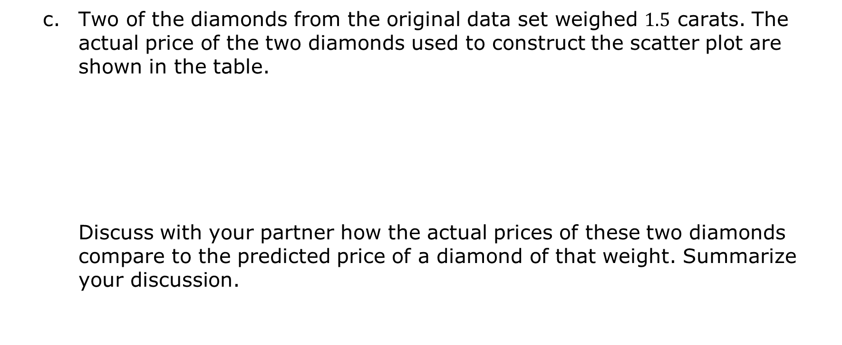
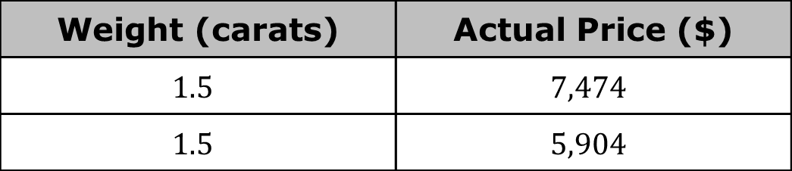
Two of the diamonds from the original data set weighed $1.5$ carats. The actual price of the two diamonds used to construct the scatter plot are shown in the table.
Discuss with your partner how the actual prices of these two diamonds compare to the predicted price of a diamond of that weight. Summarize your discussion.
Weight (carats) | Actual Price ($)
$$1.5$$ | $$7,474$$
$$1.5$$ | $$5,904$$
volume 1, pg. 134

Slide 19

The line fit to the data in a scatter plot is used to model the association between the variables. It can be used to make estimates or predictions, but the actual values may fall above or below the line.
An association is a way to describe the form, direction, or strength of the relationship between the two variables in a bivariate data set. For numerical data, descriptions include linear or nonlinear; positive or negative; strong or weak.
volume 1, pg. 134

Slide 20
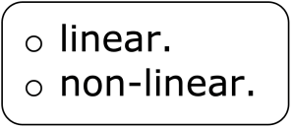
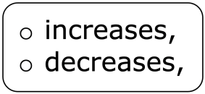
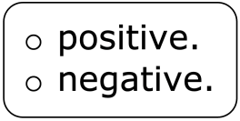
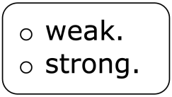
Complete the statements to describe the patterns of association for the scatter plot.
The relationship between a diamond’s weight and price is As a diamond’s weight the price so the trend is The data points closely follow the line of fit, so the pattern of association is
volume 1, pg. 135

Slide 21
Complete the table to describe the pattern of association for each scatter plot.
Scatter Plot A
Pattern of Association | linear positive strong | non-linear negative moderate | neither weak
volume 1, pg. 135

Slide 22
Scatter Plot B
Pattern of Association | linear positive strong | non-linear negative moderate | neither weak
volume 1, pg. 135

Slide 23
Scatter Plot C
Pattern of Association | linear positive strong | non-linear negative moderate | neither weak
volume 1, pg. 135

Slide 24

Guided Instruction
volume 1, pg. 136

Slide 25
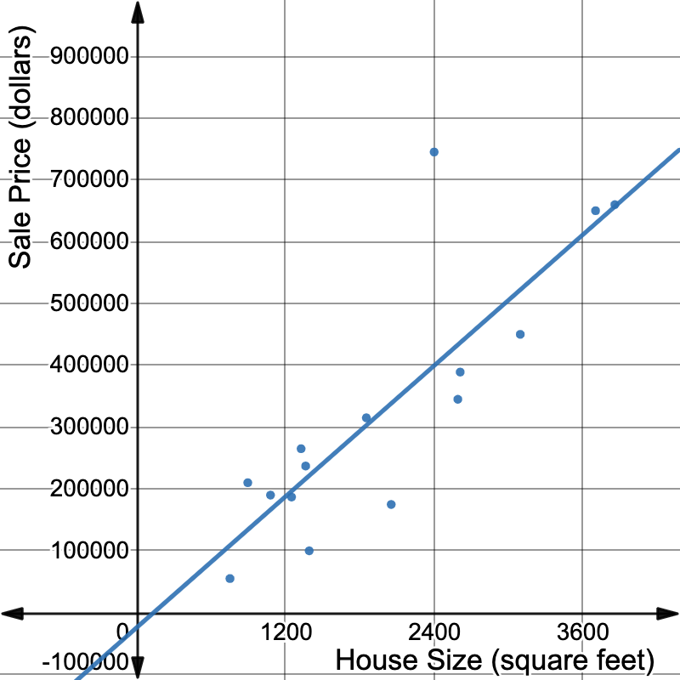
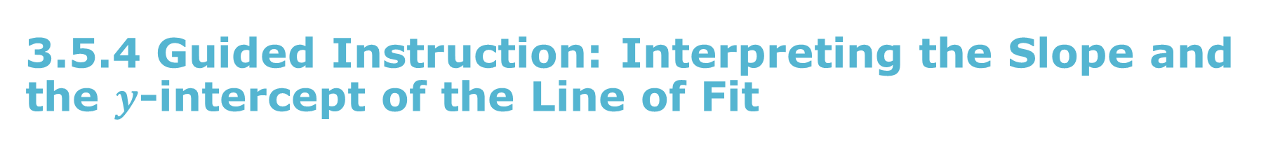
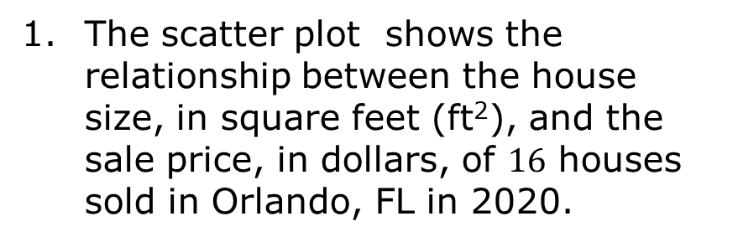
3.5.4 Guided Instruction: Interpreting the Slope and the $y$-intercept of the Line of Fit
The scatter plot shows the relationship between the house size, in square feet (ft²), and the sale price, in dollars, of $16$ houses sold in Orlando, FL in 2020.
volume 1, pg. 136

Slide 26
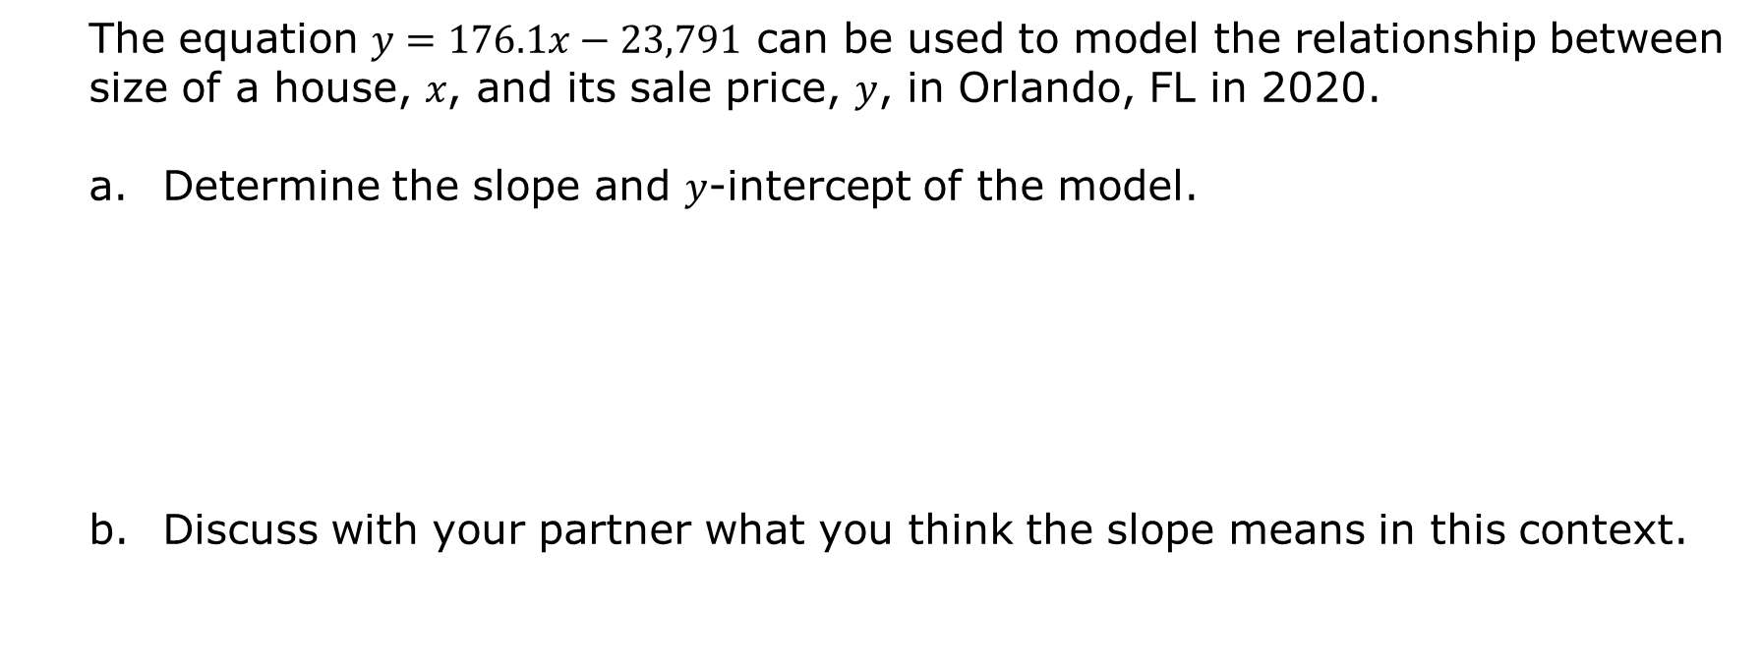
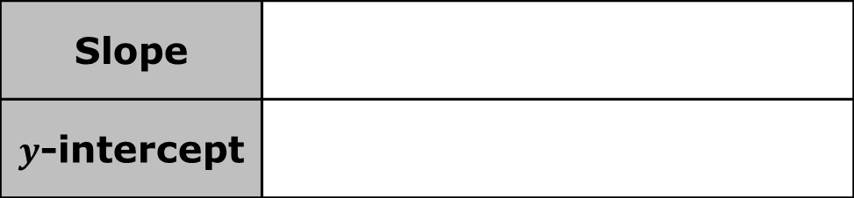
The equation $y=176.1x−23,791$ can be used to model the relationship between size of a house, 𝑥, and its sale price, 𝑦, in Orlando, FL in 2020.
Determine the slope and 𝑦-intercept of the model.
Discuss with your partner what you think the slope means in this context.
Slope
$y$-intercept
volume 1, pg. 136

Slide 27
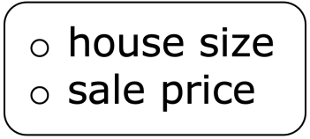
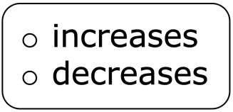
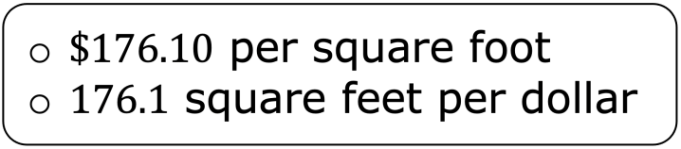
Complete the statement. In this context, the slope means the for homes in Orlando, FL in 2020.
volume 1, pg. 136

Slide 28
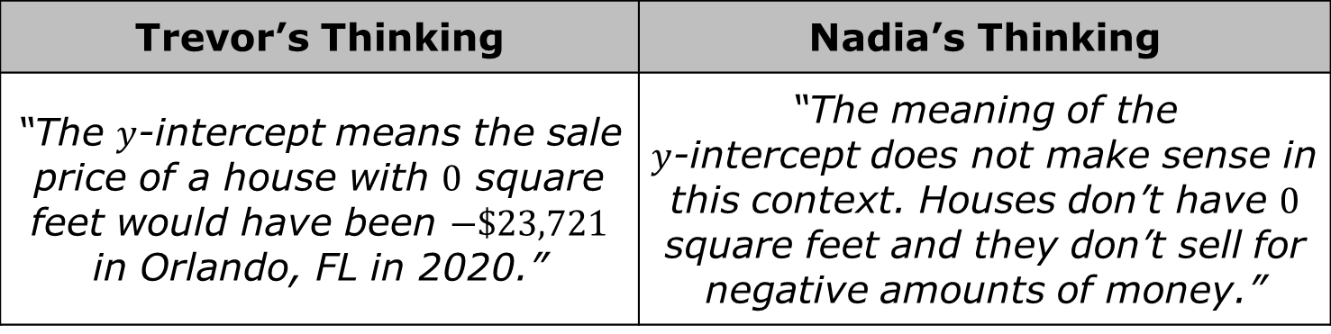
Trevor and Nadia both considered the meaning of the 𝑦-intercept in this context. Each student’s thinking is shown in the table.
Discuss Trevor’s and Nadia’s thinking with your partner.
Trevor’s Thinking | Nadia’s Thinking
“The $y$-intercept means the sale price of a house with $0$ square feet would have been $−\$23,721$ in Orlando, FL in 2020.” | “The meaning of the $y$-intercept does not make sense in this context. Houses don’t have $0$ square feet and they don’t sell for negative amounts of money.”
volume 1, pg. 136

Slide 29
Determine an appropriate domain and range for the context, expressed as inequalities.
Domain
Range
volume 1, pg. 136

Slide 30

Wrap-Up
volume 1, pg. 137

Slide 31
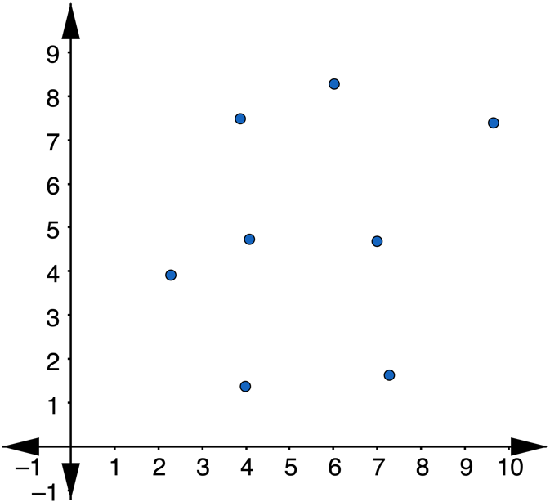
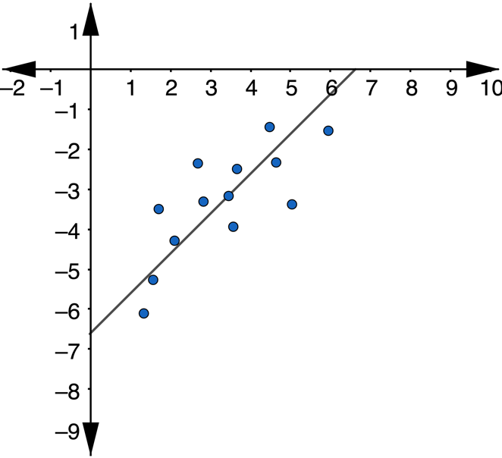
3.5.5 Wrap-Up: Cool Down
Four scatter plots are shown.
Scatter Plot A | Scatter Plot B
volume 1, pg. 137

Slide 32
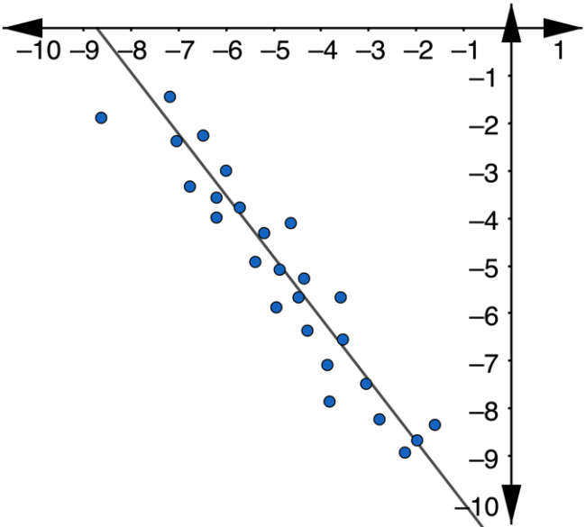
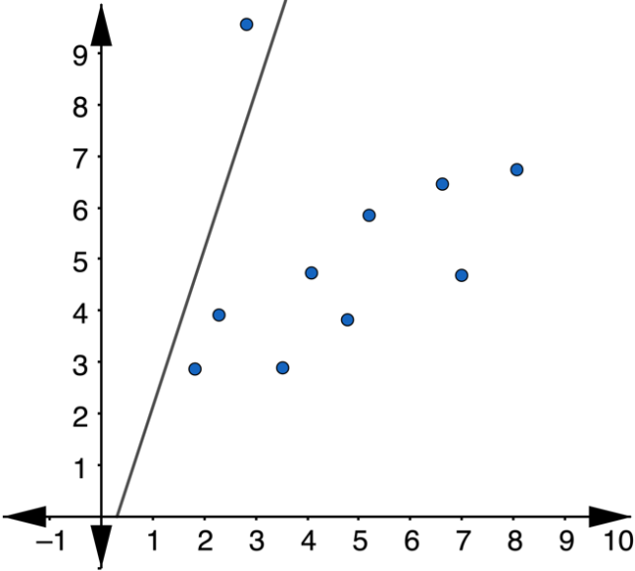
Scatter Plot C | Scatter Plot D
Complete each statement to explain why one of the scatter plots doesn’t belong with the others. Use a different scatter plot to complete each statement.
Scatter plot ___ doesn't belong because ...
Scatter plot ___ doesn't belong because ...
volume 1, pg. 137

